Slide 1
The British Approach to Understanding and Treating Psychosis
Robin M Murray
Professor of Psychiatric Research
Department of Psychosis Studies
Institute of Psychiatry
robin.murray@kcl.ac.uk

Slide 2
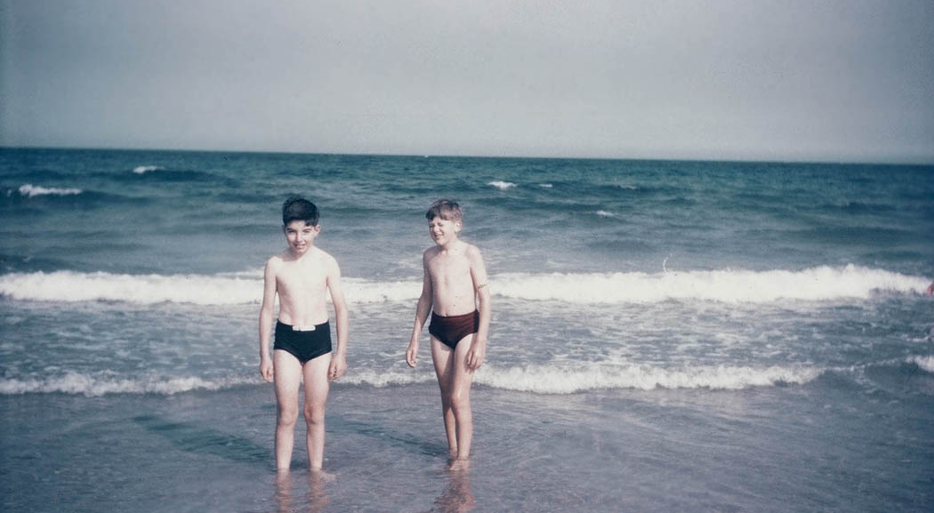
Which boy will develop schizophrenia?

Slide 3
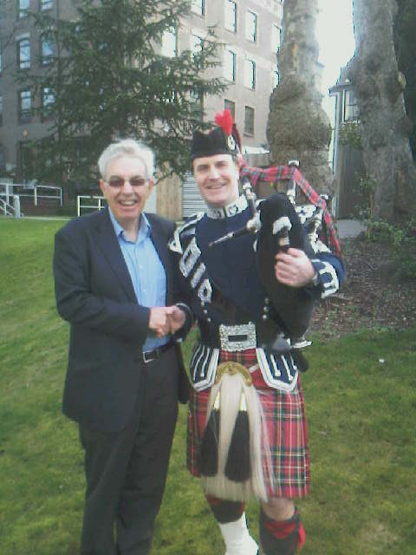
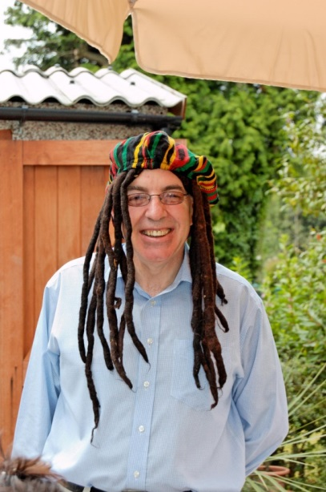


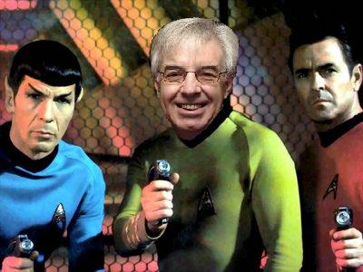

Slide 4

Now we know there are >100 genes, this is not compatible with the idea schizophrenia exists as a discrete entity. It suggests instead that there is a continuum of liability to psychosis
Normality
Sz
Psychosis
Notes:
If seen from dimensional view it’s not that different from other neurotic disorders, just more extreme - Indeed there’s lots of evidence now even from the psychiatric rather than the psychological literature that psychosis does lie on continuum, and that looking at symptoms or syndromes is more helpful clinically than diagnoses; and of course symptoms themselves lie on a continuum

Slide 5
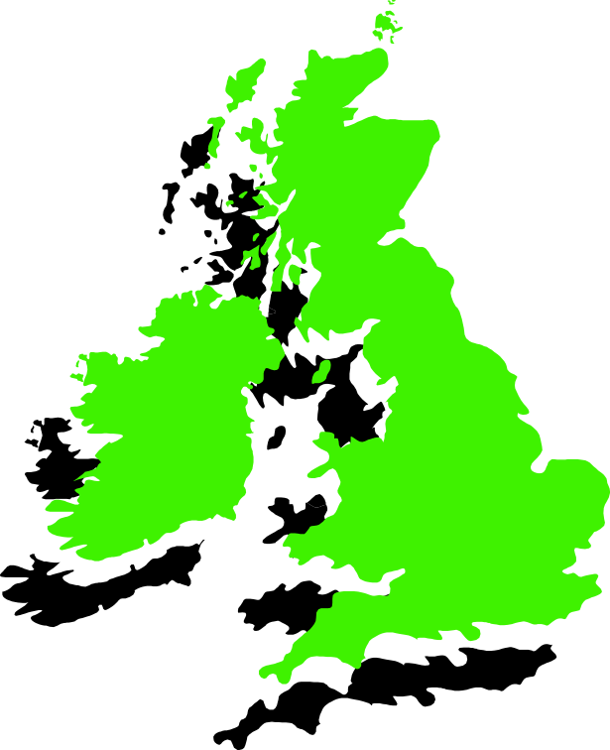
Environmental Factors that increase the risk of schizophrenia
Childhood Adversity, including bullying
Being a migrant/ethnic minority
Adverse Life Events
Cannabis Use
Living in a City
Nottingham
South East
London
Bristol
Kirkbride, Morgan et al 2006, 2007,2008

Slide 6
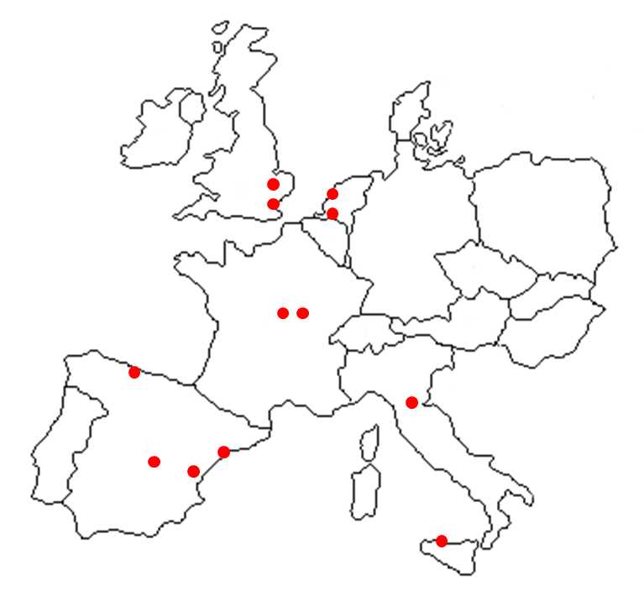

Incidence of First Episode Psychosis across 16 sites - ranged from 12.0 per 100,000 person years in Palermo to 63.9 per 100,000 in London
Cambridge-=19
London =64.9
Netherlands=40
France- 26
Spain-21.8
Bologna-Verona =204
Palermo=12.8

Slide 7
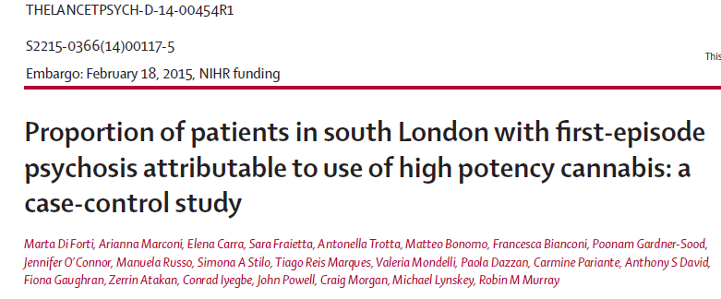
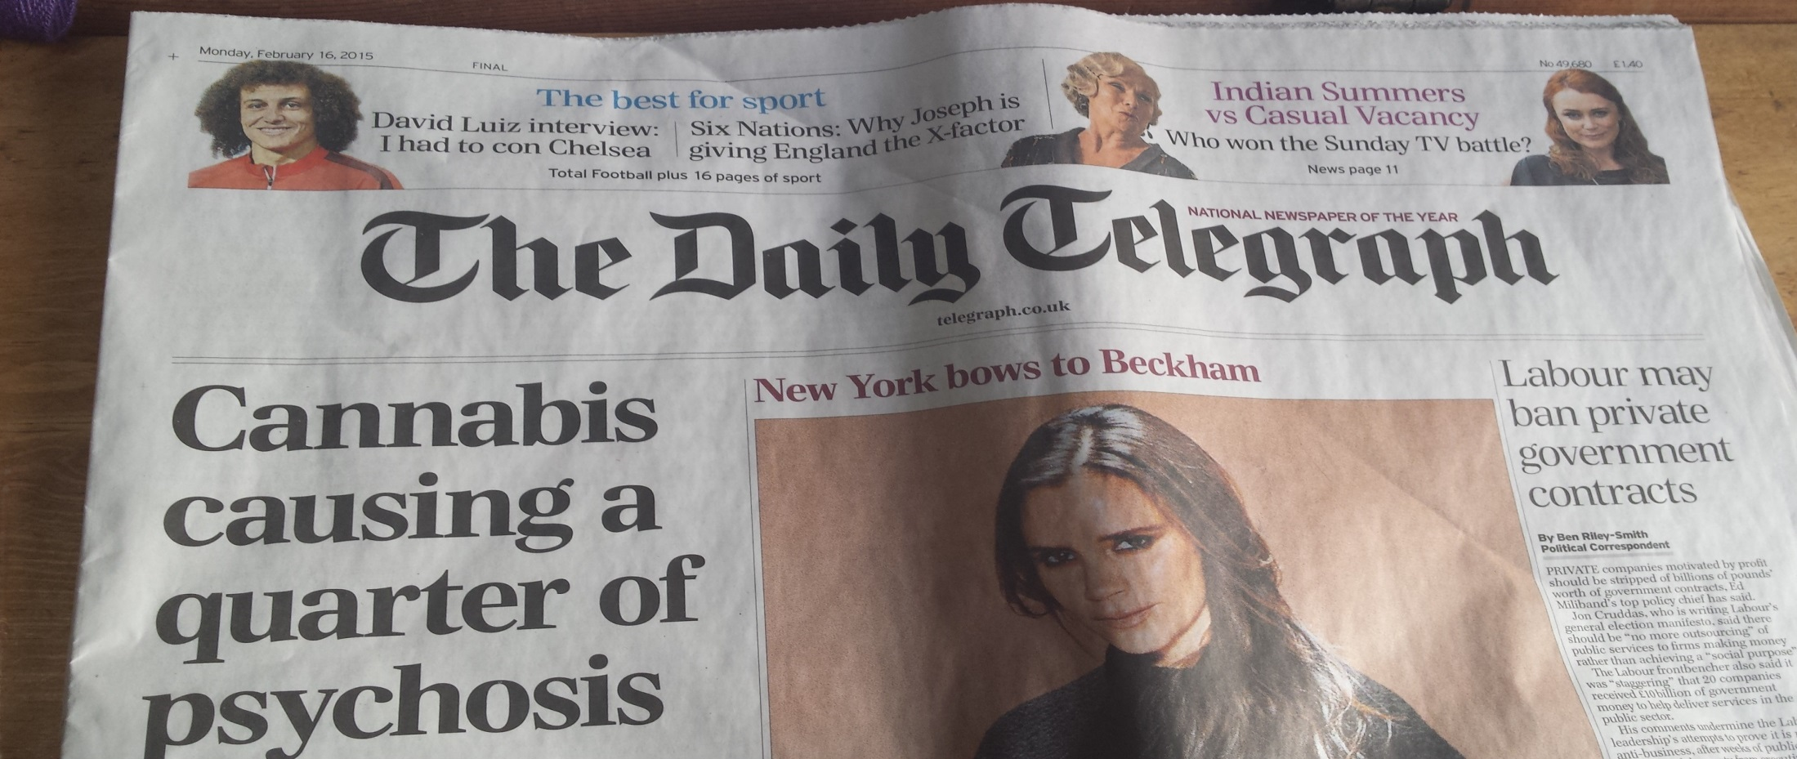
CI: confidence interval.

Slide 8
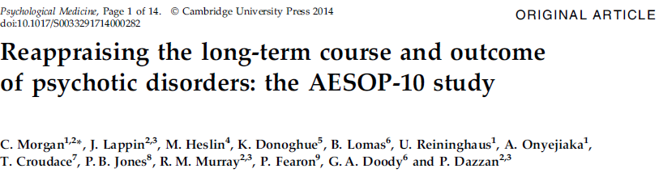
AESOP, Aetiology and Ethnicity in Schizophrenia and Other Psychoses
Morgan et al. Psychol Med 2014;44:407–419

Slide 9
How were 387 patients functioning at ten years?
65% had no psychotic symptoms at 10 years
46% had had none for >2 years (40% of those with a diagnosis of Schizophrenia)
21% overall and 19% of people with schizophrenia
had no psychotic symptoms and were not taking antipsychotics
Morgan et al. Psychol Med 2014;44:407–419

Slide 10
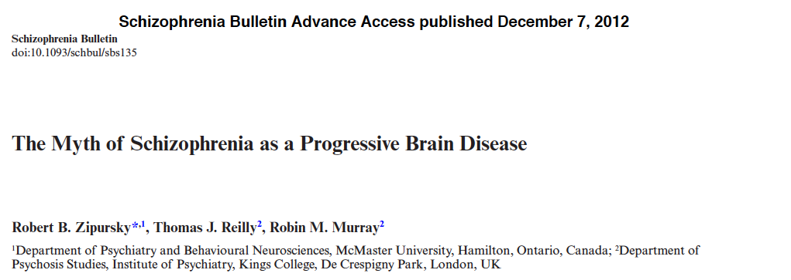
Clinical outcome is better than we think
There is no evidence of intrinsic progressive brain changes
There is no evidence of progressive cognitive changes

Slide 11
What events precede psychosis?
Early
environmental
factors
Stress
isolation
Drug abuse
P
S
Y
C
H
O
S
I
S
Subtle motor,
cognitive and
social deficits
Social anxiety,
depression
Neurotransmitter
dysregulation
Genetic factors
Neurotransmitter genes
0
5
10
15
20
Age (years)
Premorbid phase
Prodrome phase
Onset
Adapted from Murray et al. Eur Neuropsychopharmacol 2008;18:S129–S134

Slide 12
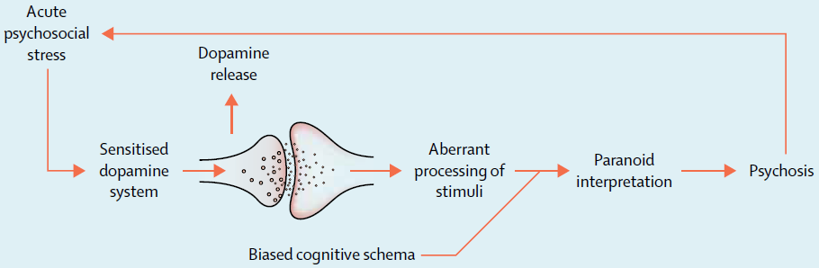
An Integrated Model of Schizophrenia
Howes & Murray Schizophrenia: an integrated sociodevelopmental-cognitive model. Lancet ,383, p1677–1687, 10 May 2014

Slide 13
The UK View of Psychosis and Schizophrenia
Less wedded to the medical model of schizophrenia as a brain disease
Regard Psychosis as one end of a continuum of psychosis, and schizophrenia simply as the most severe variety
More open to the idea that social factors play a major causal role
Patients and their families have to be involved in development of services

Slide 14
Main characteristics of UK mental health care
Each geographic area is served by a “catchment area” service
Average length of a hospital admission is about 28 days
Within each service, the local mental health team has a responsibility for the psychotic patient until he/she is handed to another service e.g. family doctor/specialist service
Patient must have a care plan on discharge including place to live and follow-up care

Slide 15
Advantages and disadvantages of a socialist system
It is “free”
National standards can be set (though not always met)
Evidence-based treatments are prioritised
Funding is dependent on Government Policy – UK spends about 9% of GNP on Health Care, same as in main European countries

Slide 16


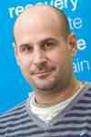
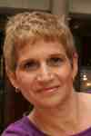

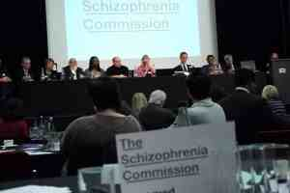
PHGB/XEP/0113/0066
January 2013

Slide 17
What do people appreciate?
1. Kindness and competence
2. Continuity of care.
3. Home Treatment
4. Early Intervention.

Slide 18
Most helpful people
Community nurses – 25%
Psychiatrists – 18%
Social workers – 17%
Psychologists – 12%
Medication – 73%
CBT – 40%
Peer support – 30%
Most helpful treatments
PHGB/XEP/0113/0066
January 2013
CPN, community psychiatric nurse; CBT, cognitive behavioural therapy

Slide 19
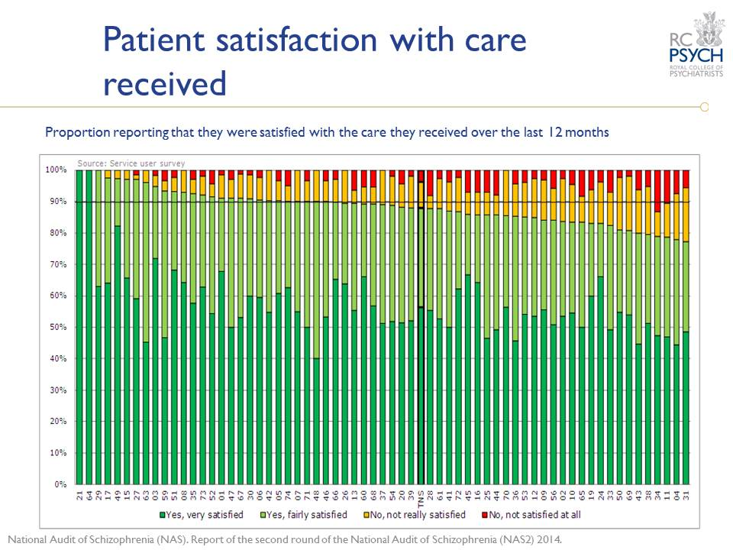

Slide 20
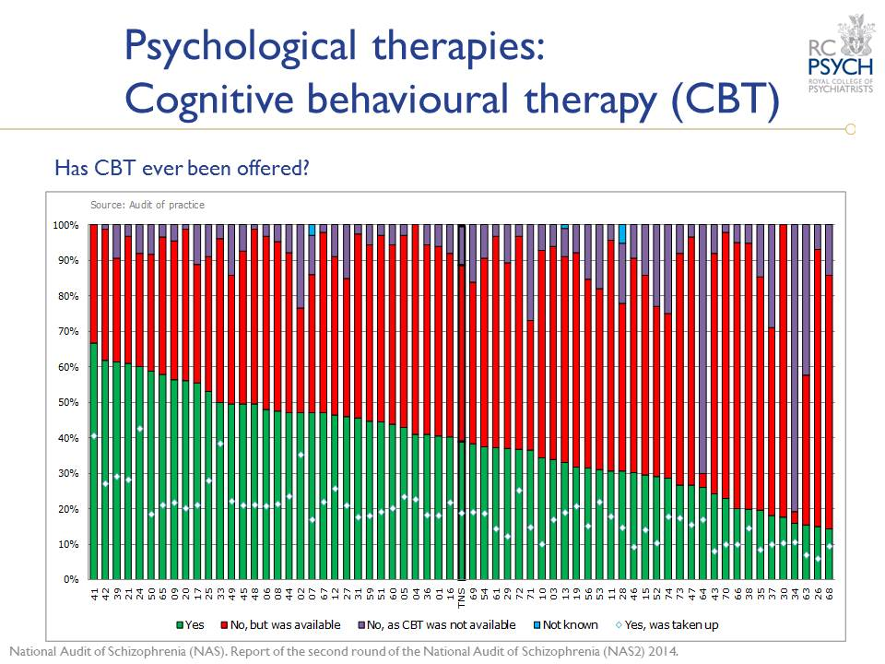

Slide 21
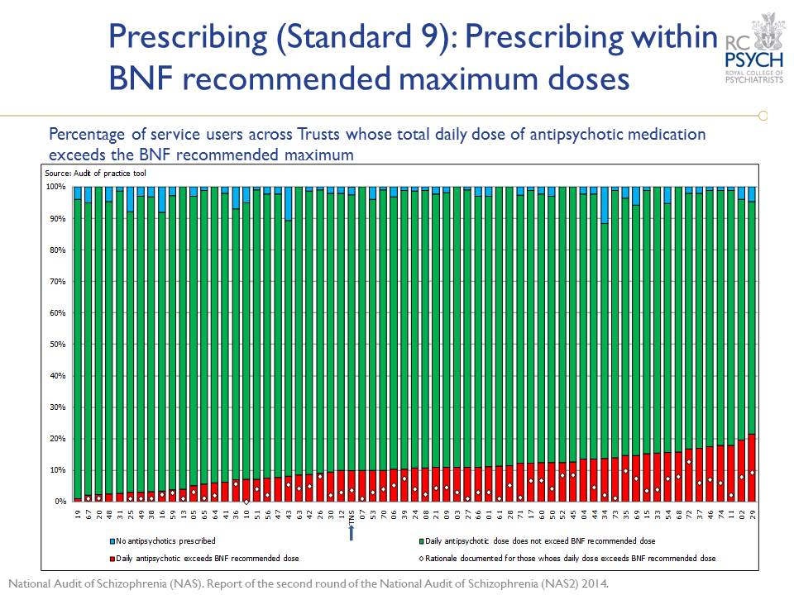

Slide 22
Early Intervention for psychosis (2001)
Provide treatment for the first 3 years after onset
All services must provide this
Two main components
  Early detection
  Integrated psychosocial treatment
  Evidence for benefit of the assertive follow-up component of EIS on outcome (relapse) is clear with two high quality RCTs
  But benefits not sustained at 5 years possibly because by then pts transferred to standard care

Slide 23
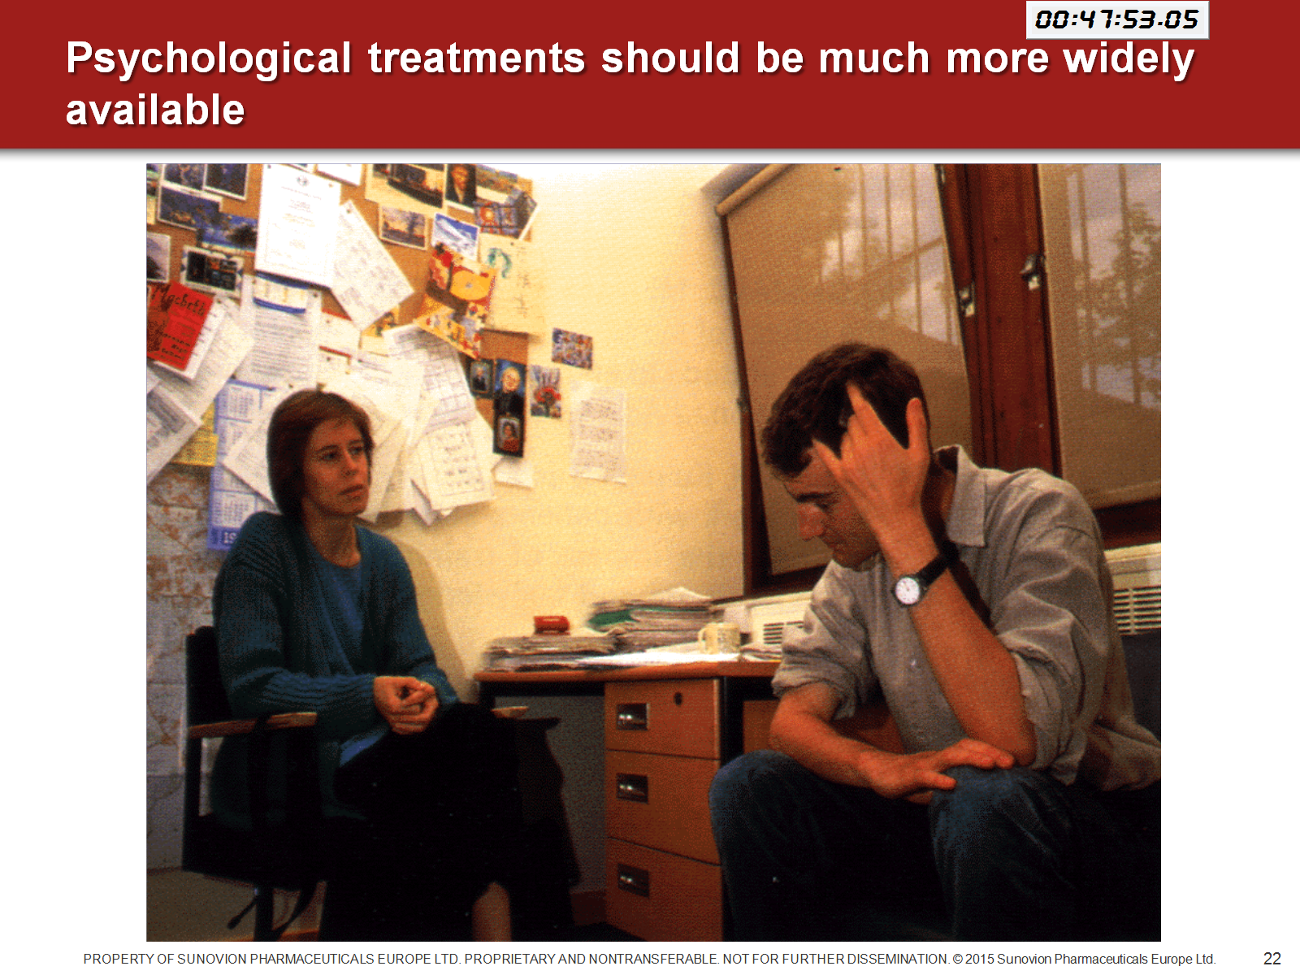
Psychological treatments should be much more widely available

Slide 24
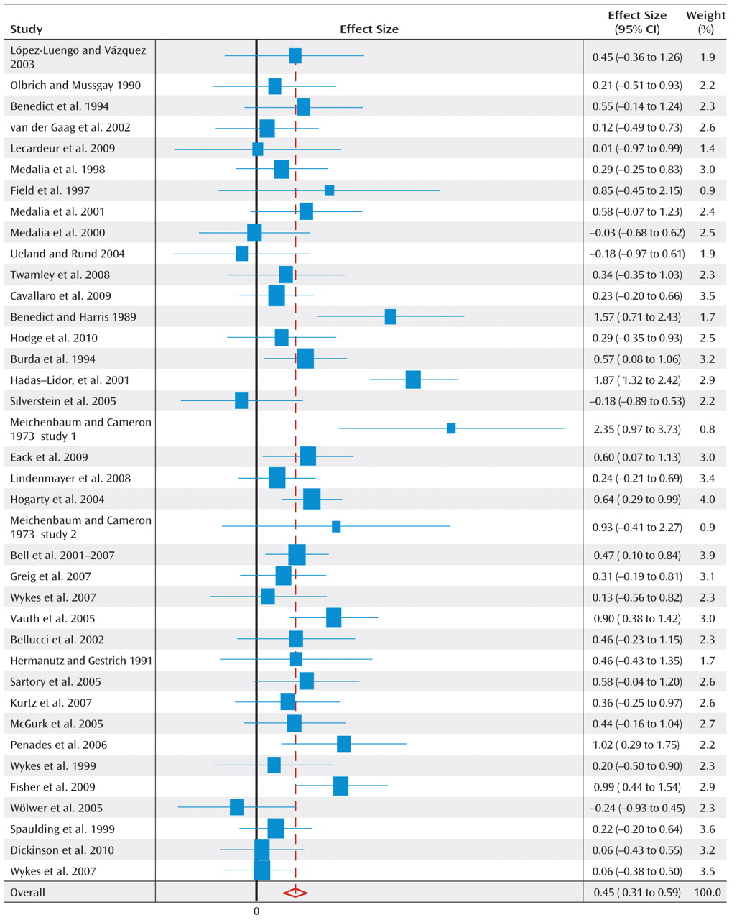
Cognitive remediation treatment (CRT)
Many studies show that CR has a beneficial effect on cognition
It also improves occupational function and this is a durable effect (effect on symptoms is not)
Not yet widely available

Slide 25
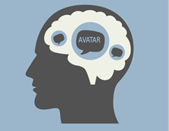






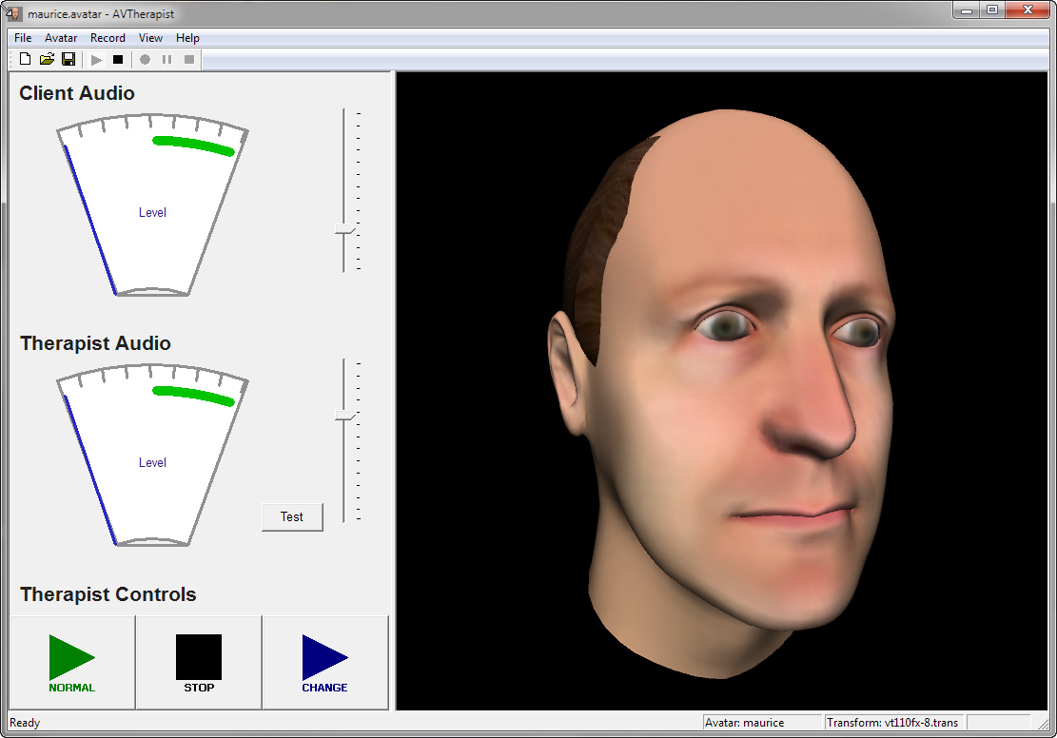
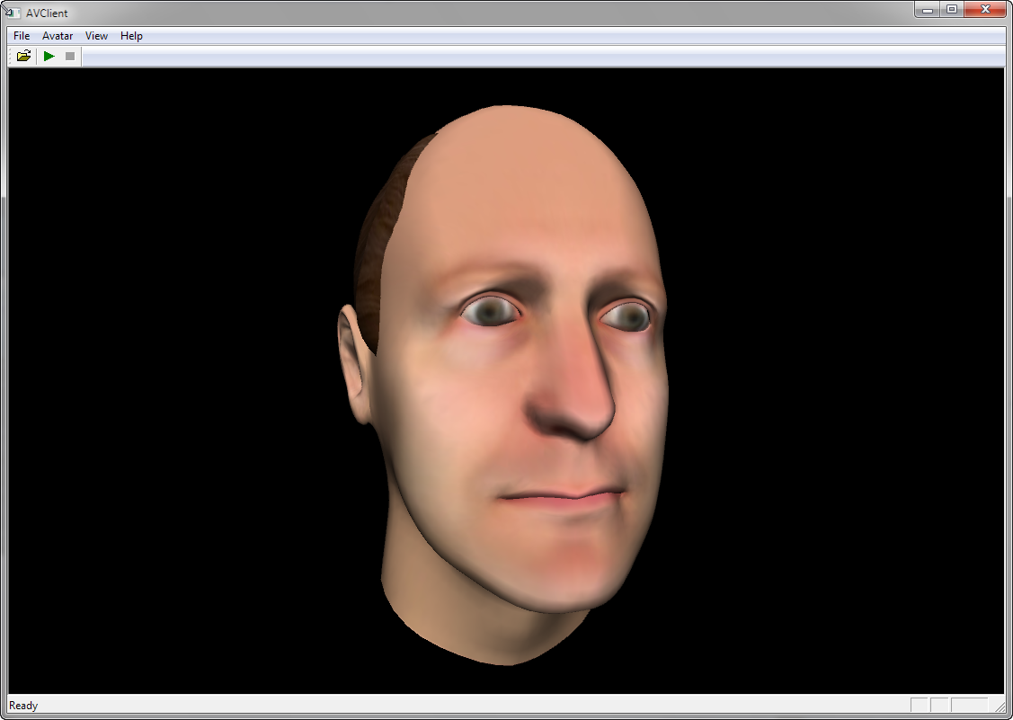

AVATAR Therapy: AVATAR
(Leff et al 2013)
Empty chair replaced by computer simulation (avatar).
The avatar is constructed to look like and sound like what the patient reports experiencing.
Clinician speaks as himself or through voice transforming software as the ‘voice’
Therapy ingredients: exposure-desensitisation, increase sense of power and control over the voice, coping and other distress management techniques
7 x 45 min sessions
Amplifier
Clinician
Normal
Client
Audio IO
Audio
Lip Sync
Room partition
Morphed
Voice
Changer
& Push-
to-talk
Animated
Head
PC
MP3 recording to take home

Slide 26
Does it work?
Leff et al 2013
Pilot RCT (n=24) Compare therapy with waiting list control
3 patients stop hearing voices altogether
Significant reductions in other measures
Small study, inactive control, large drop out
Craig et al ongoing
RCT (n=150) compare avatar to supportive counselling control for attention/time
Trial complete, awaiting outcome data
>80% complete therapy
> 80% complete end of therapy outcomes (blinded)
Outcome results including 6/12 follow up expected September 2016

Slide 27
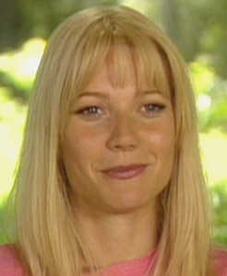
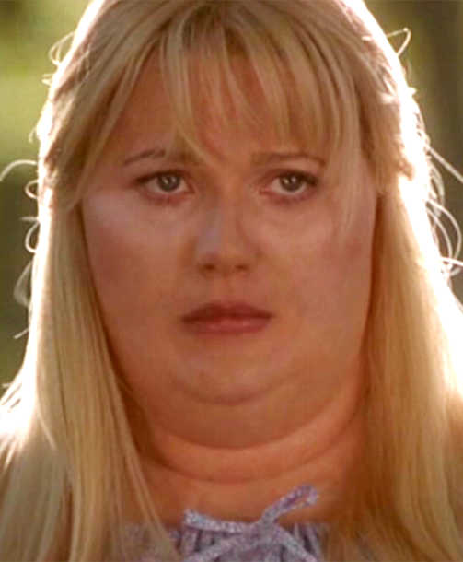
Images for illustrative purposes only.
Notes:
27
The interest about weight gain and metabolic syndrome comes from my/our clinical experience and my/our concern when I/we prescribe certain types of antipsychotic drugs to a patient that present psychotic symptoms (who’s probably not as cute as Gwyneth Paltrow) and she comes back after few weeks like this, with a weight gain of 20 pounds.

Slide 28
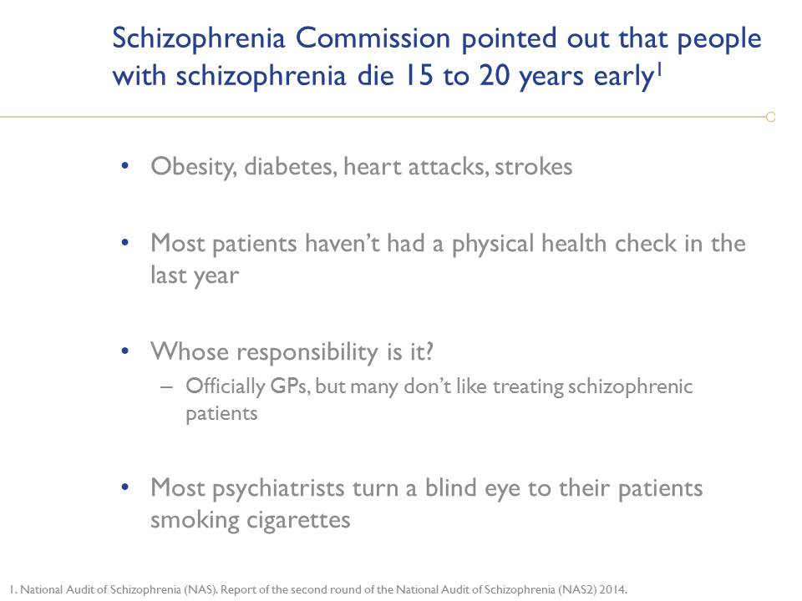

Slide 29
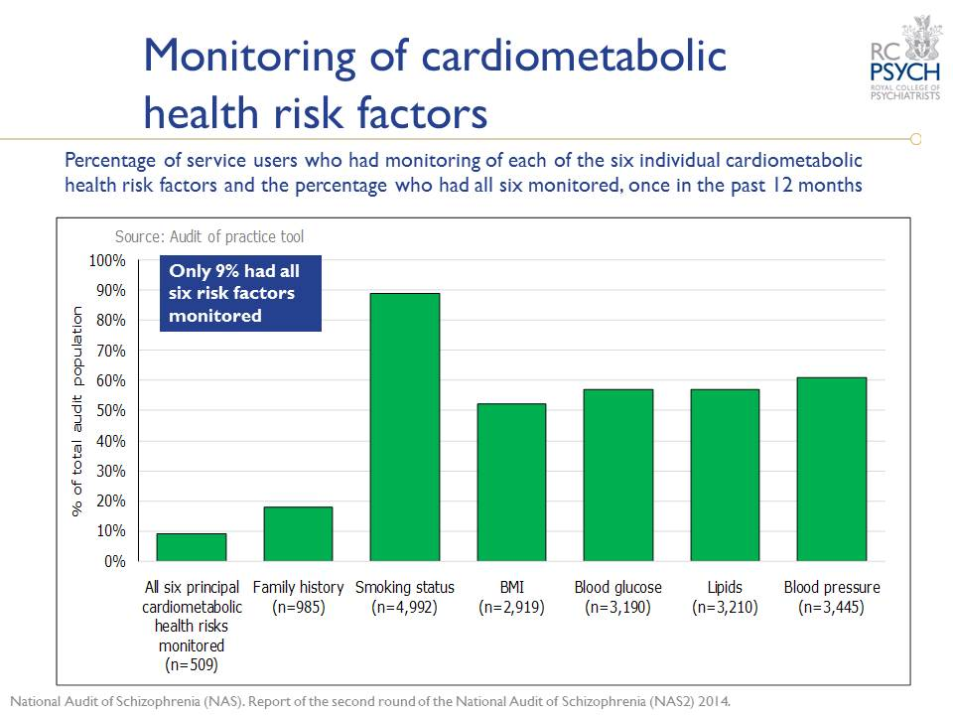

Slide 30

ACUTE PSYCHOTIC EPISODE
Response
Relapse
Remission
Partial response
RECOVERY
Refractoriness

